Slide 1
Self-introduction of Du Xinyu
CSt1909131

Slide 2

Basic information about me
文本
This is my hometown
Name : Du Xinyu
Nationality : China
Native place : Fu Jian
Major : CST

Slide 3
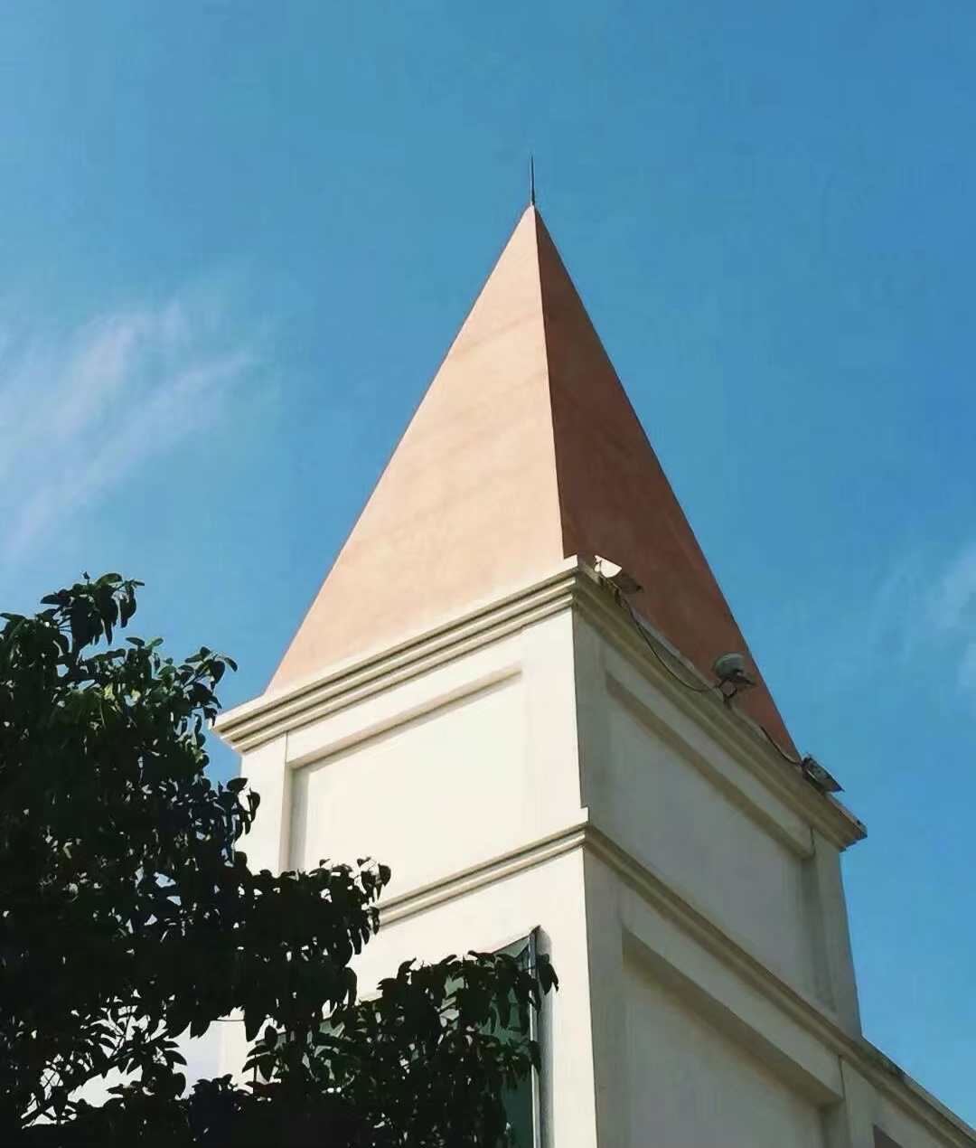
My education experience
文本
Primary school : Xiamen music school
Junior high school : Xiamen music school
High school : Xiamen No.2 middle school
University : XMUM

